Slide 1

Fair Use
Copyright

Slide 2
Do you know WHAT IS COPYRIGHT?

Slide 3
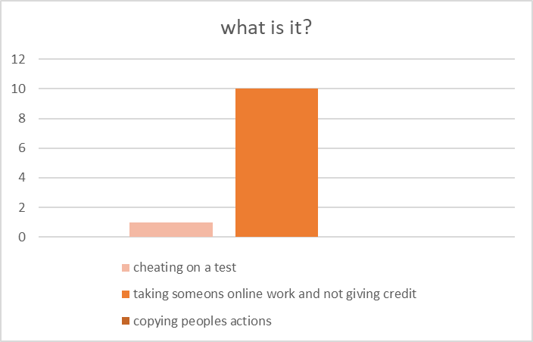
WHAT IS COPYRIGHT?

Slide 4

What is copyright?
It is when you take something online that isnt yours and dont give credit to the owner.
Giving credit to the owner “Fair use copyright” is a law.

Slide 5

how does if afect you?
~ It is against the law
~ You can get sued
~ It can risk your creative work
~ People can take your work and give no credit
~ With no copyright there is no way to protect your work and economic interests

Slide 6
Have you ever experienced it?

Slide 7
Tips to avoid it!
Create your own content
Get explicit permission
Use creative or common stock content
Learn more about the topic.
Use references
Understand the copyright law

Slide 8
References:
Copyright logo image: http://www.casas-asin.com/qu-tanto-conoces-los-derechos-de-autor-o-copyrights
“How to Not Get Sued” DBS Interactive https://www.dbswebsite.com/blog/2016/02/23/how-not-to-get-sued-six-copyright-myths-you-need-to-know/ (Oct 8 2018)
“3. Copyright Myths “ Plagarism Today https://www.plagiarismtoday.com/stopping-internet plagiarism/your-copyrights-online/3-copyright-myths/ (Oct 8 2018)
“Copyright & fair use” https://fairuse.stanford.edu/ (Oct 8 2018)

